Slide 1
Toomer ES
Notes:
Good Morning/Afternoon! Today we begin the process of planning our school’s budget for FY21. I know we are all here for the same reason and that is ensuring success for all (enter school name) students. This meeting is to provide an overview of the draft budget and for you to give feedback on the draft budget.

Slide 2
Norms
This is a meeting of the GO Team. Only members of the team may participate in the discussion. Any members of the public present are here to quietly observe.
We will follow the agenda as noticed to the public and stay on task.
We invite and welcome contributions of every member and listen to each other.
We will respect all ideas and assume good intentions.

Slide 3
GO Team Budget Development Process
YOUR SCHOOL STRATEGIC PLAN…
is your roadmap and your role. It is your direction, your priorities, your vision, your present, your future.
Step 1: Data Review
Step 2: Strategic Plan Review
Step 3: Budget Parameters
Step 4: Budget Choices
Notes:
Today I will provide an overview of the budget allocations for FY21. We will begin the work of funding the strategic priorities we agreed upon during our strategic review meeting. (IF YOU HAVE NOT DECIDED ON YOUR PRIORITIES, YOU WILL SAY – WE WILL DECIDE ON OUR PRIORITIES AND THEN DISCUSS ALLOCATING FUNDS TO ADDRESS THOSE PRIORITIES).

Slide 4
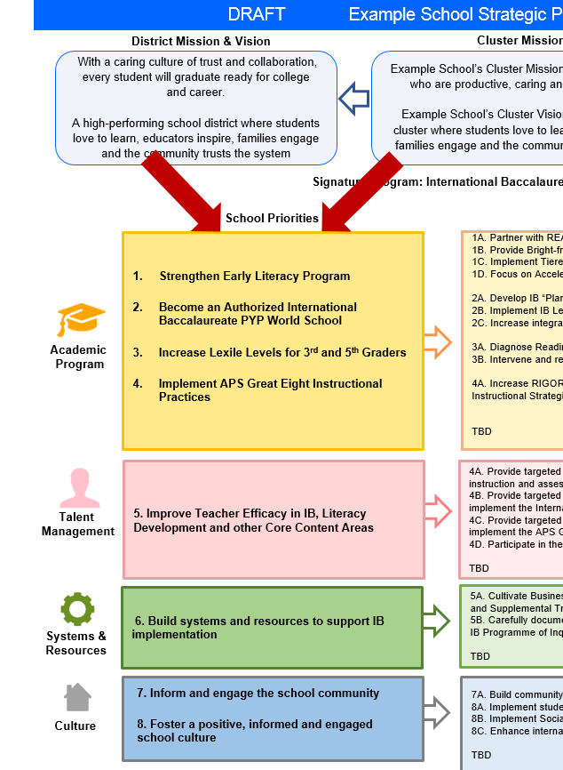
FY21 Budget Development Process
Principal’s Role
Design the budget and propose operational changes that can raise student achievement
Flesh out strategies, implement and manage them at the school level
Focus on the day-to-day operations
Serve as the expert on the school
Hire quality instructional and support personnel
The GO Team’s Role:
Focus on the big picture (positions and resources, not people)
Ensure that the budget is aligned to the school’s mission and vision and that resources are allocated to support key strategic priorities

Slide 5
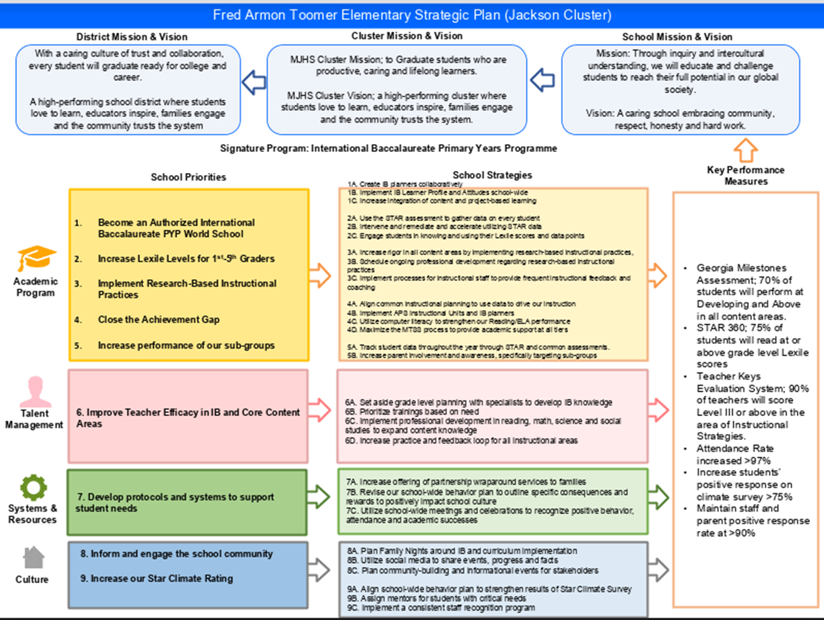
Toomer ES Strategic Plan
Notes:
You should have a copy of our updated strategic plan (please make copies to be distributed to team).

Slide 6
FY21 Priorities & SMART Goals
(From your Strategic Plan, insert your Top 2 Priorities & SMART Goals for FY21 here)
School Priorities
SMART Goals
Implement Research-Based Instructional Practices
Increase the percentage of students scoring in the proficient and above on the Reading, Math, Science and Social Students Georgia Milestones Assessment by May 2021.
Develop protocols and systems to support student needs
Increase the STAR rating on the Georgia CCRPI Measurement by May 2021.
Notes:
Based on your data and your existing strategic plan, principals & GO Teams should confirm or craft two priorities for 2020-2021.
Definition:
Key focus areas that address your school needs
Broad enough to address multiple domains (Academics, Talent, System, Culture)
Led with a “continuous improvement” verb
Clear, concise, compelling
Measurable
Provides direction to stakeholders (students, staff, families, community)
Priorities are high-level, whereas, strategies get to the how and individual needs/barriers of a school
Discuss priorities and rationale
Principals & GO Teams should confirm or craft a SMART Goal that will address each of your two priorities (one goal each).
Ensure goals are specific, measurable, achievable, relevant, and time-bound

Slide 7
FY21 Budget Parameters
FY21 School Priorities | Rationale
Implement Research-Based Instructional Practices | Majority of students continue to score in the beginning and developing learner areas on the Georgia Milestones. This is considerably higher than like schools in the district.
Develop protocols and systems to support student needs | STAR rating on the CCRPI continues to drop indicating we need to focus on our systems and protocols around student discipline, student and staff attendance and student and staff climate.
Notes:
Discuss priorities and rationale. After you have gone over the priorities and rationale – ask GO Team if this represents what was agreed upon.
Are there any priorities I left off?
Are there any questions or concerns?
The next time we meet, I will show you how I have allocated resources to support our strategic priorities.

Slide 8
Discussion of Budget Summary
(Step 4: Budget Choices)

Slide 9
Executive Summary
This budget represents an investment plan for our school’s students, employees and the community as a whole.
The budget recommendations are tied directly to the school’s strategic vision and direction.
The proposed budget for the general operations of the school are reflected at $5,958,348
This investment plan for FY21 accommodates a student population that is projected to be 446 students, which is a increase of 33 students from FY20.
Notes:
Here’s a few highlights for our budget this year – read executive summary

Slide 10
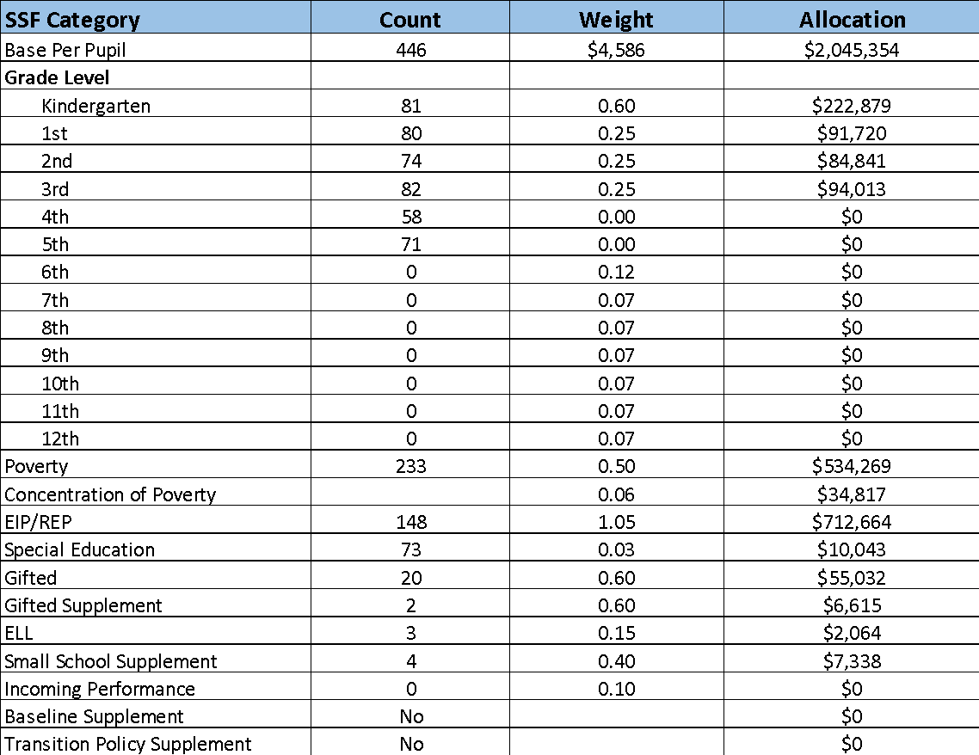
School Allocation
Notes:
For FY21, APS is continuing to increase equity within the District and the flexibility principals have in regards to our schools budgeted funds. The new Student Success Funding Model (SSF) allocates dollars to schools based on the number of enrolled students and receives a funding "weight" based on need. This year, student characteristics were weighted based on:
Grade Level –
K
1st through 3rd
6th
9th
Poverty – Weighted for all Direct Certification enrolled students.
Beginning Performance – Weighted Middle School and High School students entering with beginner’s performance on milestones.
ESOL – Weighted for all ESOL designated students in order to supplement due to ESOL staff being locked.
Special Education - Weighted for all Special Education students.
Gifted – Weighted and measured by number of students in the Gifted Program
Small School Supplement – Weighted for low enrollment schools
ES – 500
MS – 600
HS – 700
As you can see, our projected enrollment for FY19 is _______, we increased/decreased by __________ from last year.
We received the following weights for our student characteristics: (Below is just for the script, principals need to insert their school’s characteristics)
Grade Level
Poverty
Special Education
Gifted
Gifted Supplement
ELL
Small School Supplement

Slide 11
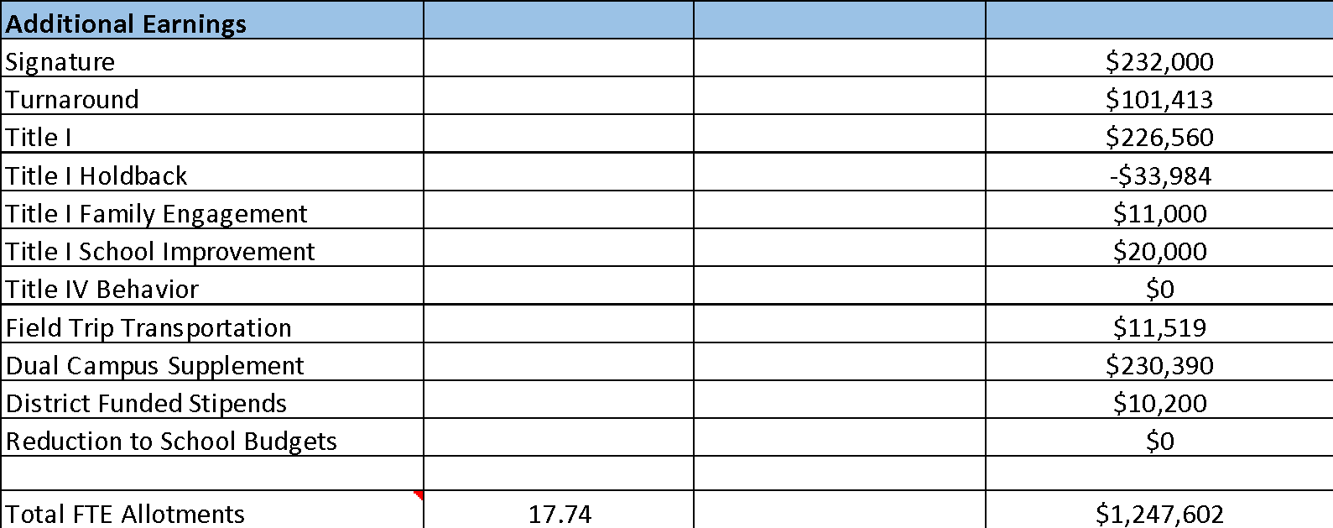
School Allocation
Notes:
Additionally, we received money for signature programming, turnaround, Title I and FTE Allotments.

Slide 12
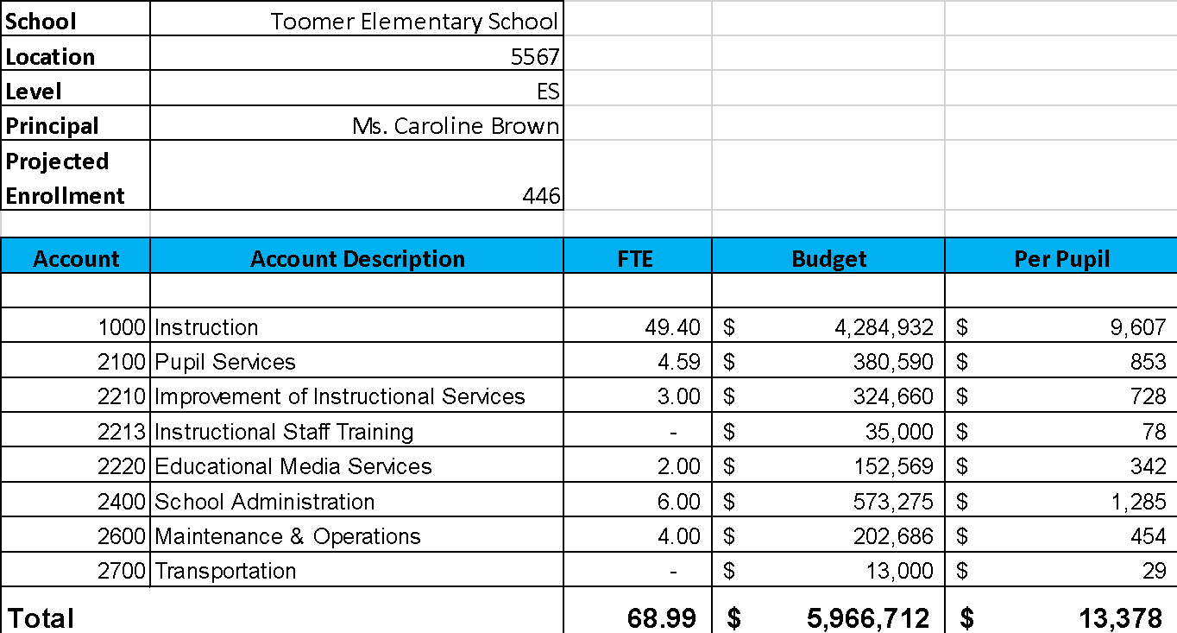
Budget by Function (Required)
Notes:
I am passing out the definitions for these funding categories. You will see what makes up each category. Although the total amount will not change, allocation per function may depending on our conversations and school needs.

Slide 13
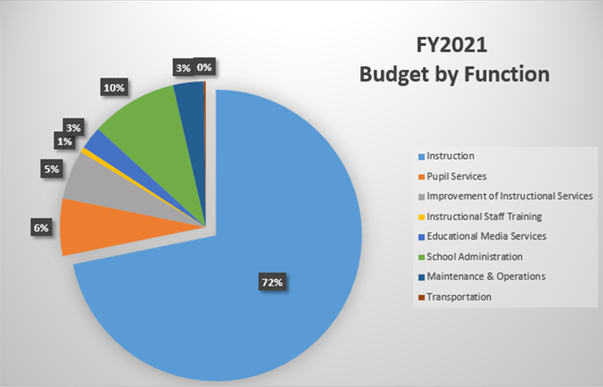
Budget by Function (Required)
Notes:
Explain the pie chart and allocations

Slide 14
Focus Area Descriptors
Strategic Plan Categories | District Descriptions of Categories
Academic Program | Our students will be well-rounded individuals who possess the necessary academic skills and knowledge and are excited about learning.
Talent Management | We will retain an energized and inspired team of employees who are capable of advancing ever-increasing levels of achievement for students of all backgrounds.
Systems & Resources | We will improve efficiency (productivity, cost, etc.) while also making decisions (including resource allocations) that are grounded in a strategic academic direction and data.
Culture | We will build trust with the community, and we will have engaged stakeholders (employees, students, parents, community members, partners, etc.) who are invested in the mission and vision and who support the creation of student-centered learning communities.
Notes:
I have printed the terms on the next two slides for your convenience. I want to just go over them so we will all be on the same page as we move forward in this process. If you have any questions, please don’t hesitate to ask.

Slide 15
Description of Strategy Categories
Budget Parameters – FY21 funding priorities from the school’s 3-5 year strategic plan, ranked by the order of importance
Strategies – Lays out specific objectives for schools improvement
Request – “The Ask”. What needs to be funded in order to support the strategy?

Slide 16
FY21 Budget Parameters
FY21 School Priorities | Rationale
Closing the achievement gap | Achievement gap at Toomer is wider than other like schools in the cluster.
Increase percentage of students at proficient or above | Majority of students are beginning and developing learners.
Protocols and systems to support student needs | STAR rating continues to fall.
Develop a mathematics framework | Students scoring in beginning and developing continue to grow in math.
Notes:
Review the priorities that the GO Team has developed and the rationale for these priorities

Slide 17
FY21 Strategic Plan Break-out
Priorities | Focus Area | Strategies | Requests | Amount
Closing the achievement gap | Academics | Small group support around guided reading and phonics instruction. | Add additional DSE reading specialist | 93,123
 |  | Average class size 19 | 23 Home room teachers | 2,141,000
 |  | Reading specialist to support small group instruction | Reading specialist | 93,123
 |  | Small group instruction in first grade | 2 paraprofessionals to support | 168,000
 | Talent Management | Create a Master Teacher for k-2 | Stipend a teacher to support additional data review for small group | 2000
 | Systems and Resources | Create a Literacy Lab that supports small group instruction | Materials | 5000
Notes:
For the next few slides, I will show you how I have allocated the budget to support our strategic priorities.
Based on our strategic priorities and funds we received, here is a break-out of the priorities, which focus area it addresses, the strategies that will be implemented, the purchase request, which funding source was used and the amount.

Slide 18
FY21 Strategic Plan Break-out
Priorities | Focus Area | Strategies | Requests | Amount
Increase percentage of students at proficient and or above | Academics | Intervention 3-5 | Reading Specialist
 | Talent Management | Professional Development in literacy | PD: summer and Fall | 30,000
 | Talent Management | Provide subs for pd | Subs | 80,000
Develop protocols and systems to support student needs | Culture | Full time Counselor Implementation of Check and Connect and SEE Curriculum | Adding .5 to position | 53,000
 | Talent Management | Additional professional development for Assistant Principal | Subs to cover | 1000
Notes:
Based on our strategic priorities and funds we received, here is a break-out of the priorities, which focus area it addresses, the strategies that will be implemented, the purchase request, which funding source was used and the amount.

Slide 19
FY 2021: Purpose of Reserve Funds
To account for the district’s overall revenue uncertainty & help to mitigate potential losses at leveling
2% of school’s SSF allocation has been budgeted for NonStaffing
Use of these funds is subject to District Approval
Notes:
The reserve can be impacted at two points in the budget process: 1. During the summer, dependent upon district revenues matching projections and 2. After the 15-day count for enrollment leveling.

Slide 20
Plan for FY21Reserve
Priorities | Focus Area | Strategies | Requests | Amount
Closing achievement gap | Talent Management | Professional Development | Subs | 45,000
Increase percentage of students at proficient or above | Academics | Provide job embedded pd in enquiry based instructional practice | Math tools and systems for maintaining | 20, 000
Notes:
This slides represent the priorities we will fund if we receive additional money from Title I and the Leveling Reserve. When we approve the budget we will approve both so that we will not have to schedule another meeting if the funds are made available.
Before I turn it back over to the Chair for the next slide, I want to thank you for your hard work and support this year. I will keep you informed as we move through the budget process. (Please inform Chair that they will facilitate the discussion for the last slide)

Slide 21
Plan for FY21 Title I Holdback and Family Engagement Funds
Priorities | Focus Area | Strategies | Requests | Amount
Develop protocols and systems to support student needs | Culture | Increase communication from the school and increase accessibility to the school for all families | Transportation Snack Materials | 11,000
Closing achievement gap | Academics | Increase participation in summer programing | Extended day for summer | 33,0000
Notes:
This slides represent the priorities we will fund if we receive additional money from Title I and the Leveling Reserve. When we approve the budget we will approve both so that we will not have to schedule another meeting if the funds are made available.
Before I turn it back over to the Chair for the next slide, I want to thank you for your hard work and support this year. I will keep you informed as we move through the budget process. (Please inform Chair that they will facilitate the discussion for the last slide)

Slide 22
Questions to Consider
Are our school’s priorities (from your strategic plan) reflected in this budget?
Are new positions and/or resources included in the budget to address our major priorities?
Do we know (as a team) the plan to support implementation of these priorities beyond the budget (ex. What strategies will be implemented)?
What tradeoffs are being made in order to support these priorities?
2. How are district and cluster priorities reflected in our budget?
Cluster priorities- what staff, materials, etc. are dedicated to supporting our cluster’s priorities?
Signature programs- what staff, materials, etc. are dedicated to supporting our signature program?
Are there positions our school will share with another school, i.e. nurse, counselor?
Notes:
CHAIR - Our final task for today! Here are questions that we need to consider to ensure we have a good working draft budget. Let’s walk through them together.

